Slide 1
Boolean Algebra
S.SADHISH PRABHU

Slide 2
INTRODUCTION
1854: Logical algebra was published by George Boole → known today as “Boolean Algebra”
  It’s a convenient way and systematic way of expressing and analyzing the operation of logic circuits.
  1938: Claude Shannon was the first to apply Boole’s work to the analysis and design of logic circuits.

Slide 3
Boolean Operations & Expressions
Variable
Complement
Literal
A symbol used to represent a logical quantity
The inverse of a variable and is indicated by a bar over the variable
A variable or the complement of a variable.
.

Slide 4
Boolean Algebra
Section 01

Slide 5
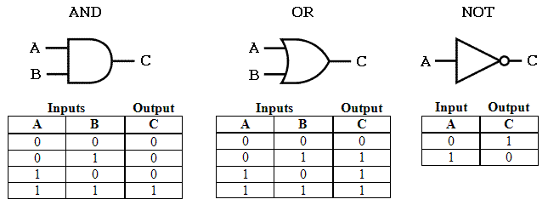
Boolean Algebra
A Boolean operator can be completely described using a truth table.
The AND operator is also known as a Boolean product.
The OR operator is the Boolean sum.
The NOT operation is most often designated by an overbar. It is sometimes indicated by a prime mark ( ‘ ) or an “elbow” (¬).

Slide 6
Why Boolean Algebra?
Turning Point
With this in mind, we always want to reduce our Boolean functions to their simplest form.
Now
#3
There are a number of Boolean identities that help us to do this. .
The simpler that we can make a Boolean function, the smaller the circuit that will result.
#4
Simpler circuits are cheaper to build, consume less power, and run faster than complex circuits.
#1
Digital computers contain circuits that implement Boolean functions.
#2

Slide 7
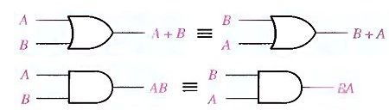
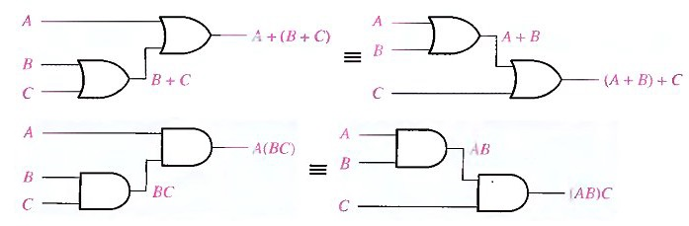
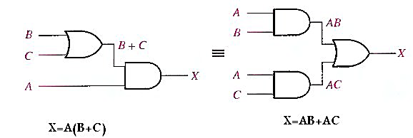
LAWS OF BOOLEAN ALGEBRA
Commutative
Associative
Distributive
This law states that the order in which the variables are OR ed makes no difference..
This law states that when ORing more than two variables, the result is the same regardless of the grouping of the variables
This law states that ORing two or more variables and then ANDing the result with a single variable is equivalent to ANDing the single variable with each of the two or more variables and then ORing the products..

Slide 8
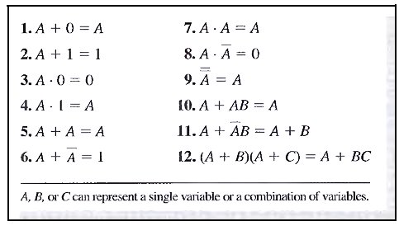
Identity law
Idempotent law
Complement law
Dominance law
Involution law
Identity law
Idempotent law
Complement law
Rules of Boolean Algebra
Rules 1 through 9 will be viewed in terms of their application to logic gates.
Rules 10 through 12 will be derived in terms of the simpler rules and the laws previously discussed.

Slide 9
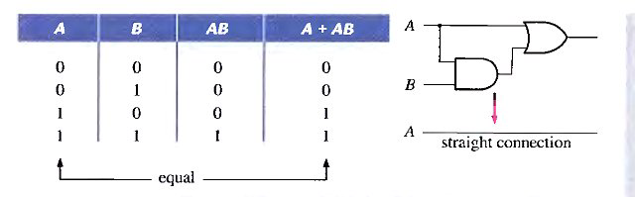
Rule 10 : A + AB = A
A + AB = A( 1 + B) Factoring (distributive law)
= A . 1 Rule 2: (1 + B) = 1
= A Rule 4: A . 1 = A

Slide 10
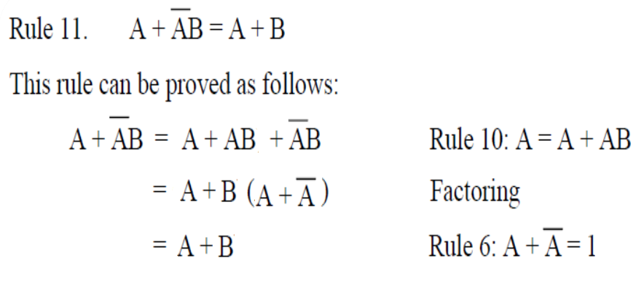
Rule 11

Slide 11
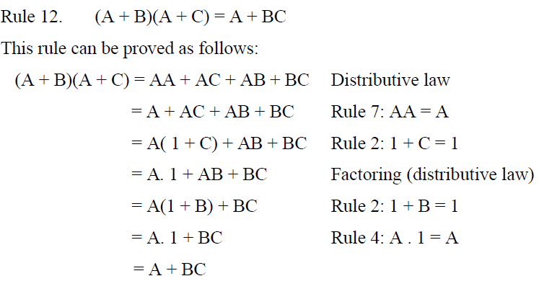
Rule 12

Slide 12
DEMORGAN'S THEOREMS
DeMorgan's first theorem is stated as follows:
The complement of a product of variables is equal to the sum of the complements of the variables.
Or
The complement of two or more ANDed variables is equivalent to the OR of the complements of the individual variables.
DeMorgan's second theorem is stated as follows:
The complement of a sum of variables is equal to the product of the complements of the variables.
Or
The complement of two or more ORed variables is equivalent to the AND of the complements of the individual variables

Slide 13
Example #1
Example
  Simplify the following Boolean expression and note the Boolean or DeMorgan’s theorem used at each step. Put the answer in SOP form.
Solution
; Using DM law
; Rule` #9 & #DM LAW
; Theorem #9
; Rewritten without AND symbols and parentheses

Slide 14
Example
Using Boolean algebra techniques, simplify this expression:
AB + A(B + C) + B(B + C)
Solution
Step 1: Apply the distributive law to the second and third terms in the expression, as follows:
AB + AB + AC + BB + BC
Step 2: Apply rule 7 (BB = B) to the fourth term.
AB + AB + AC + B + BC
Step 3: Apply rule 5 (AB + AB = AB) to the first two terms.
AB + AC + B + BC
Step 4: Apply rule 10 (B + BC = B) to the last two terms.
AB + AC + B
Step 5: Apply rule 10 (AB + B = B) to the first and third terms.
B+AC

Slide 15
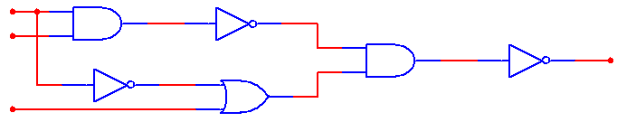
Example 2
  Solution
; DM law
; Rule 9
; DM law
; Rule 9
; Rewritten without AND symbols

Slide 16
That’s all. Thank you very much! ☺
Any Questions?
.

